Slide 1
Data extraction
Dinesh Naik​

Slide 2
AGENDA
Problem Statement
Primary Goals
​Solution
Architecture
Response UI
​Summary​

Slide 3
Problem statement
In that use case, we need to extract the information from the textual data, the ability to uncover relevant information from sentence has emerged as critical use case. The process of retrieving specific information from sentences holds immense importance across various domains. By leveraging advancements in natural language processing and artificial intelligence, researchers and developers have made significant progress in building tools and models that excel in sentence information retrieval tasks. This use case addresses the challenges, methodologies, and benefits associated with extracting information from sentences, paving the way for improved knowledge extraction from textual data.

Slide 4
PRIMARY GOALS
Identify the category, Intent and Sentiment from the sentance

Slide 5
Example
Example for the Input
I do not want the order.
Category : Order, Intent : Cancel Order, Sentiment : Neutral
I have problems with the termination of a user account.
Category : Account, Intent : Delete Account, Sentiment : Negative
How can I find my invoice.
Category : Invoice, Intent : Check Invoice, Sentiment : Neutral

Slide 6
Solution
The solution utilizes the LangChain framework and OpenAI models to extract information from sentences effectively.
By leveraging the capabilities of the LangChain framework, the solution gains access to powerful natural language processing techniques.
The OpenAI model, a state-of-the-art large language model, forms the core of the solution, enabling accurate and contextual understanding of sentences.
To enhance the model's performance in extracting relevant information, the solution incorporates few-shot learning techniques.
By retraining the model with limited annotated examples, it becomes adept at identifying and retrieving the most pertinent information from sentences.
The combination of the LangChain framework, OpenAI models, and few-shot techniques results in a robust and efficient system for extracting targeted information from sentences

Slide 7
architecture
Fast API
Logging
App Logging
Logging Config
main
Components
Read config file
OpenAI
Prompt Template

Slide 8
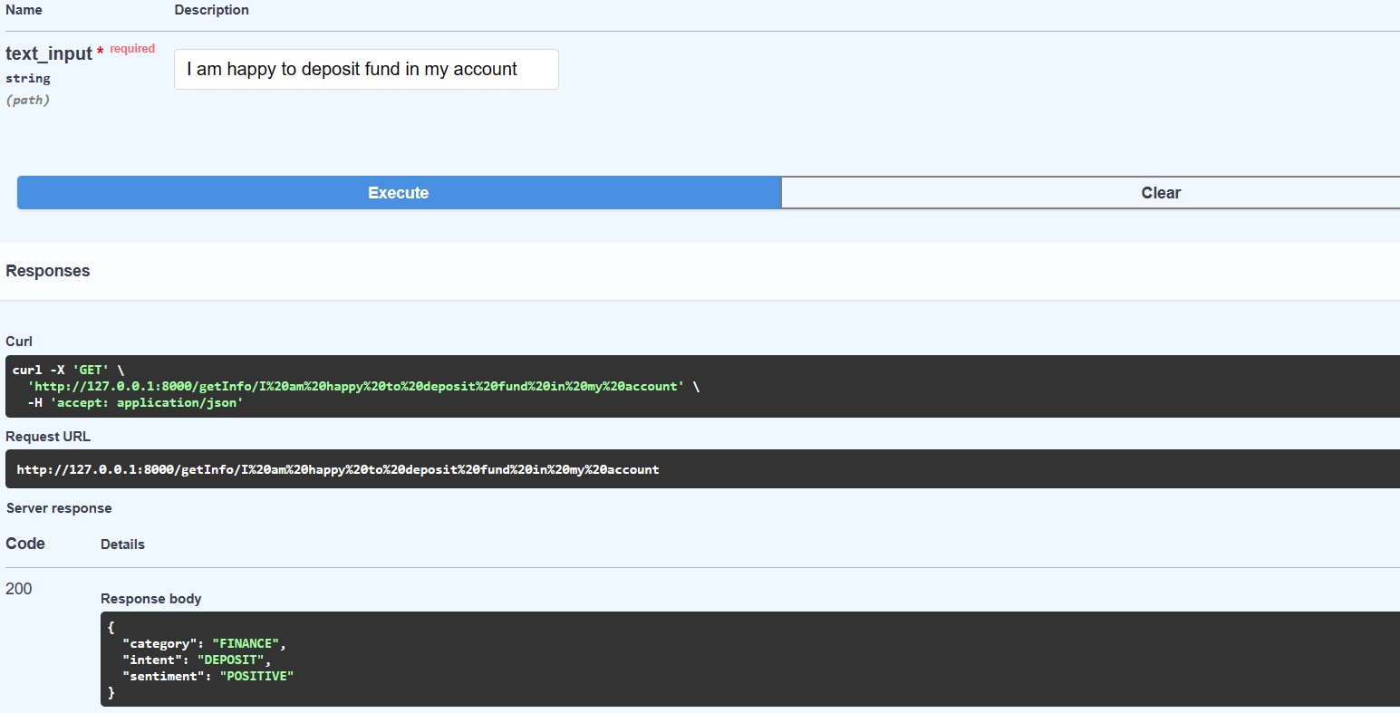
RESPONSE UI

Slide 9
SUMMARY
The developed solution, which employs the LangChain framework, OpenAI models, and few-shot learning techniques, has been transformed into an accessible and versatile API. The integration of the FastAPI framework enables seamless integration with various applications, allowing users to leverage the solution's capabilities for extracting information from sentences. With the solution exposed as an API, developers and users can easily incorporate its functionality into their applications, harnessing the power of natural language processing and efficient information retrieval. This API-driven approach enhances the solution's usability and opens up opportunities for its integration across diverse domains and applications.

Slide 10
THANK YOU
Dinesh Naik
Dinesh13n@gmail.com

